Slide 1
Overview of SPP implementation in the world IX Conferencia Annual de la Red Interamericana de Compras Gubernamentales – Montevideo 17 September 2013 Farid.yaker@unep.org

Slide 2
Ways of commitment
Many countries have committed to SPP
Different ways and different levels
Maximum level = National Constitution
Global strategies on sustainable development
Environmental protection policies and strategies
Sectoral policies with SPP obligations
SPP plans
Notes:
Ideally the political framework and obligations of SPP are deployed from the top, more general level, which defines the general guidelines, down to the specific level of sector policies that determine specific obligations for groups of specific products and services.

Slide 3
General Commitments

Slide 4
European Union Commitment
The EU Sustainable Development Strategy (2006) sets the following goals:
achieve for 2010 on average for the entire region the adoption of green procurement practices equal to those adopted by the best performing countries in the region.
This manifests itself as a goal to have 50% of all purchases green by 2010
Notes:
European Council (2006b) Review of the EU Sustainable Development Strategy (EU SDS) – Renewed Strategy
This takes the shape in Communications and subsequent plans such as the Action Plan for sustainable consumption and production and sustainable industrial policy (2008), the presentation "Public Procurement for a better environment" (2008) and many Guidelines (laws) on a European Union level.

Slide 5
In the LAC region:
Constitution of Ecuador Art. 288: “Public procurement must comply with criteria of efficiency, transparency, quality, environmental and social responsibility.”
The Peruvian National Plan for Environmental Action 2012-2021 foresees the incorporation of “environmental criteria in … the National Public Procurement System, …".
The Colombian National Development Plan 2010-2014 requires the promotion of “green state procurement in the national and regional spheres.”

Slide 6
SPP Policies and Plans

Slide 7
SPP Policies in the European Union
Great number of action plans in almost all Member States of the European Union
Most in green public procurement
The social dimension is gaining ground
21 product groups with GPP criteria
http://ec.europa.eu/environment/gpp/eu_gpp_criteria_en.htm
Notes:
EC= European Commission

Slide 8
SPP Policies in the European Union
NAP or equivalent document approved 22: Austria, Belgium, Cyprus, Czech Republic, Denmark, Finland, France, Germany, Italy, Ireland, Latvia, Lithuania, Luxembourg, Malta, Netherlands, Poland, Portugal, Slovakia, Slovenia, Spain, Sweden, United Kingdom NAP in preparation 5: Bulgaria, Estonia, Greece, Hungary, Romania
± 80%

Slide 9
Trends in Asia
SPP (especially GPP) is making progress
Model case in Japan
Followed by Taiwan and Korea
Progress in other countries such as China, Thailand and the Philippines

Slide 10
Trends in Asia: Japan
Green Procurement Law, enacted in 2000 and applied since 2001
All Ministries and State agencies must draft an annual green procurement policy, an implementation plan and report results
All State institutions are obliged to purchase from a list of designated items (for their recycled content, energy efficiency, etc.)

Slide 11
Other countries
Brazil, Canada, USA, New Zealand,
Countries committed to SPP implementation or initiating SPP/GPP policies:
Mauritius Chile Panama
Colombia Costa Rica Vietnam
Uruguay Tunisia Ukraine
Ecuador Argentina Philippines
Lebanon Ghana Peru
Honduras
Notes:
MTF on SPP = Marrakesh Task Force on Sustainable Public Procurement
As part of the mandate of the MTF on SPP a project was launched to support Governments in developing and implementing SPP policies.

Slide 12
How is SPP implemented?

Slide 13
UNEP undertook in 2012 a research on SPP and GPP implementation by national governments around the world
Literature & Desktop Review
Country Case Studies (6)
Global Survey
(110:
Nat. Gov. + 163: Stakeholders)
Expert Interviews (19)
Chile
EU
India
Japan
Slovenia
USA
Europe: 31%
Africa: 21%
Asia/Pacific: 17%
Sth. America: 16%
Nth. America: 15%
Notes:
Exented exec summary in packet. In survey, countries only counted once for data-questions. Mix of qual and quantitative questions. Constraints – in English only and based on what was published + who responded to the survey. There is likely more than what we found…

Slide 14
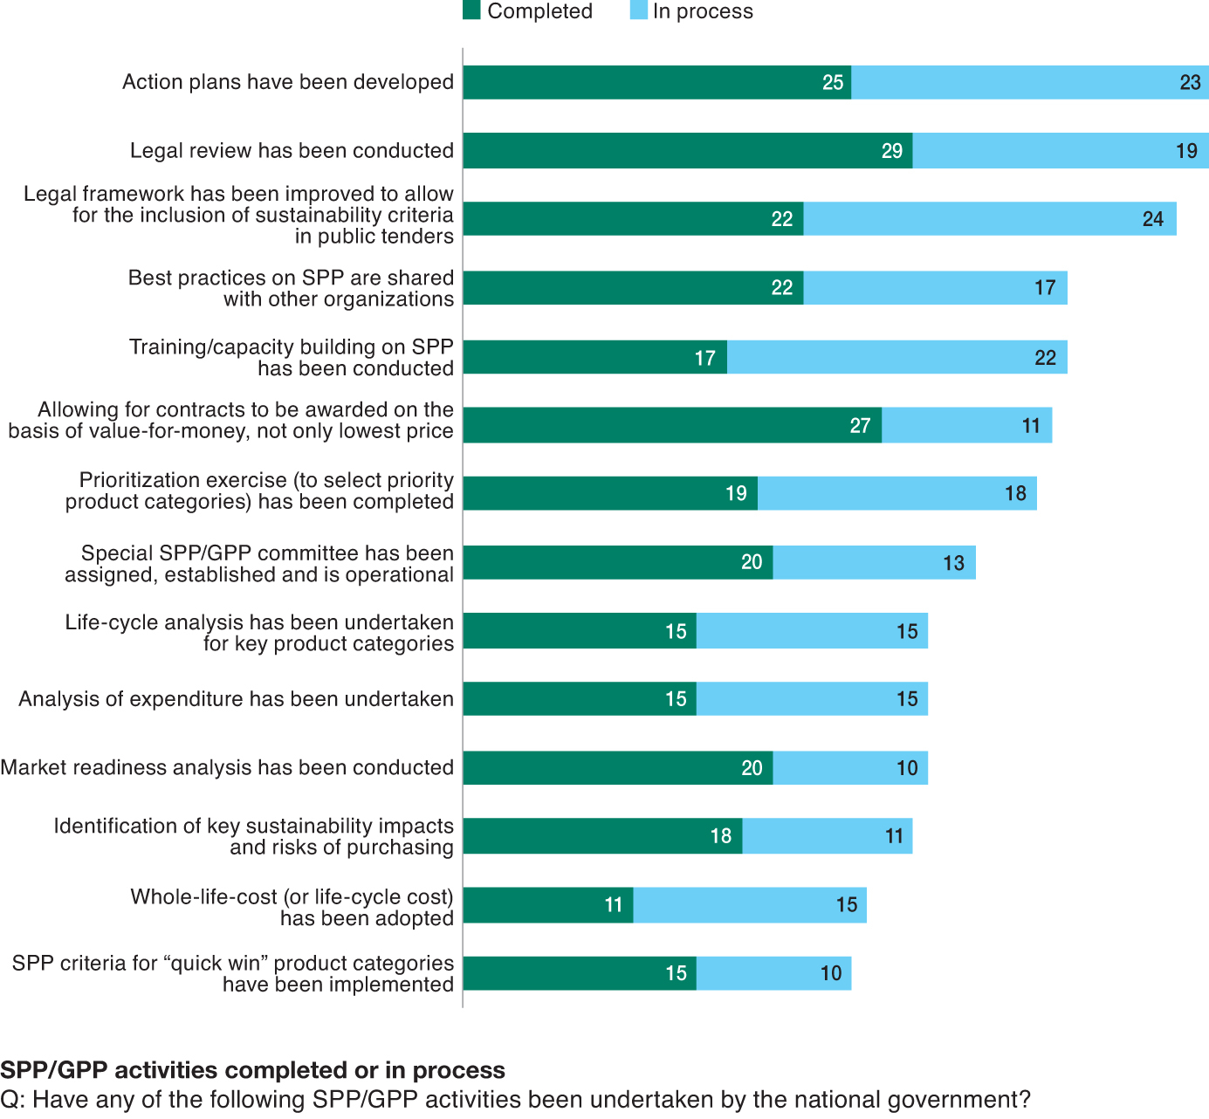
Strong foundations are being built
Notes:
Policies and targets only get you so far. As one interviewee put it – “lets see more practice, less theory”. We looked at several different implementation activities. Here is a summary of the most common activity either completed or in process. Action Plans, Legal Review, legal framework, training… less are doing the more technical work: LCAs, spend analysis, market readiness analysis, prioritisation…. Actual implementation in terms of changing what products are being bought is harder to measure.

Slide 15
Emphasis is placed on defining needs, technical specifications and contract clauses
Notes:
In the actual procurement cycle, national governments are working on SPP considerations most often in ‘needs definition, tech specifications and contract clauses”. Less work being done on spuplier engagement and audits. Will be interesting to follow up on why this is the case in future studies.

Slide 16
Lessons of SPP implementation

Slide 17
SPP cannot act alone
It is only an instrument – we need a tool kit
SPP can be much more effective if used simultaneously with other tools and instruments
It needs a political support framework
Complementary regulations and instruments
Notes:
Policy can be understood as an officially accepted statement of objectives linked to a set of activities that aim to reach certain political goals. Policies are a coherent set of instruments, generally with a schedule and plans for their implementation. They provide an operational framework for specific activities.
Instruments are understood as concrete and specific operational forms of intervention of public authorities. On a more abstract level, political instruments are defined as the set of techniques by which government authorities support and produce change (Bemelmans-Videc and others).

Slide 18
Favorable procurement framework
Transparent system and skilled personnel
It must be possible to assess not only by the cheapest offer
Includes direct reference to SPP in procurement law
Makes it possible to exclude companies as a result of failure to comply with social and/or environmental laws
Notes:
For SPP to be effective, the existing procurement system must be as transparent and accessible as possible for everyone (both large and small companies).
It must have personnel that is specialized in purchasing - this is not a simple administrative procedure, but instead it requires specific skills and abilities.
It must make it possible to assess other criteria in the selection of the companies.
A great deal may be done without the procurement law directly specifying how to implement SPP, but it greatly helps to include it, given that it clarifies how to go about it.
Exclusion of companies, see following examples.

Slide 19
European Union: Sectoral Regulations
Directive 2006/32/EC of the European Parliament and of the Council of April 5, 2006 on energy efficiency
Public Administrations must apply criteria of energy efficiency in public procurement (vehicles, IT equipment, building, power services)
To achieve a reduction in consumption of 9% by 2015.
Notes:
Directive 2006/32/EC of the European Parliament and of the Council of April 5, 2006 on energy end-use efficiency and energy services
Defines objectives, mechanisms, incentives and the financial and legal framework for eliminating existing barriers for the efficient use of energy
Establishes the objective of reduction of consumption by 9% in 2015 (1% per year, 1.5 % for Public Administrations).
Public Administrations must apply criteria of energy efficiency in public procurement (vehicles, IT equipment, building, power services)

Slide 20
European Union: Sectoral Regulations
Directive (EC) no. 106/2008 regarding an EU program of energy efficiency labeling for office IT equipment
EU institutions and national Governments:
[…] will specify certain energy efficiency requirements at least as strict as the Energy Star specifications for public supply contracts that comply with thresholds […].
Notes:
Directive (EC) no. 106/2008 of the European Parliament and the Council of January 15, 2008 regarding an EU program of energy efficiency labeling for office IT equipment
As long as the Agreement is in force, the Commission and other EU institutions, as well as the central government authorities, in accordance with Directive 2004/18/EC of the European Parliament and of the Council, of March 31, 2004 regarding coordination of the procedures for awarding public contracts for works, supply and services [10], without prejudice of EU and national legislation or of economic criteria, shall specify energy efficiency requirements no less strict than Energy Star specifications for public supply contracts that comply with thresholds established in article 7 of the mentioned Directive.

Slide 21
European Union: Sectoral Regulations
Directive 2009/33/EC on the promotion of clean and energy-efficient road transport vehicles
Take into account the environmental and energy impact related to the whole life cycle of vehicles (purchase, use, maintenance, waste) in the procurement decision:
In life cycle costs, or
As environmental specifications
Notes:
Directive 2009/33/EC on the promotion of clean and energy-efficient road transport vehicles
Requirement to take into account the environmental and energy impact related to the whole life cycle of vehicles (purchase, use, maintenance, waste) in the procurement decision:
If impact is not defined as life cycle costs (in Euros), environmental and energy efficiency criteria should be taken into account as technical specifications or criteria for award.
For instance, the European Community's GPP Toolkit criteria may be used.

Slide 22
United States: Sectoral Regulations
Executive Order 12843 (1994) Procurement Requirements and Policies for Federal Agencies for ozone-depleting substances
[…] revise procurement practices and apply cost-effective programs, both to modify specifications and contracts that require the use of ozone-depleting substances and substituting for substances that do not deplete the ozone layer […]

Slide 23
Policies for sustainable consumption
SPP refers to public sector consumption
Private demand of sustainable/green goods must also be promoted
Companies
Citizens

Slide 24
SPP and Eco-labels
Two complementary approaches to stimulate more sustainable products
SPP - demand
Eco-labels - supply
Strong correlation b/n the active use of eco-label and implementation of SPP (EU Green 7)
E.g. EU purchase of organic food or California State purchase of certified computers
Notes:
Sustainable Public procurement engages the purchasing power of the government through its public spending to stimulate better environmental and social performance of products in the market. Product labelling provides market incentive for such performance by enabling consumers to distinguish better performing products. These two approaches of voluntary labelling and public procurement together with other complementary measures constitute a SCP policy toolkit. Used in concert, they create a dynamic framework for improving performance of products throughout their life-cycle, stimulating the demand of better products and production technologies and helping consumers to make better choices. In the transition to green economy, these tools are part of enabling conditions each playing an important role in the overall market transformation towards an economic model which enhances natural capital, reduces resource scarcity and environmental and social risks.
The experience of countries performing well in implementing GPP demonstrates that existence and use of ecolabelling programme in the country can contribute to implementation of sustainable procurement practices by creating demand and supply of locally produced sustainable products. EU has played a leading role in establishing the first ecolabelling scheme and regional ecolabels (EU Flower and Nordic Swan) and has Green 7 countries the best performing in GPP
Examples: The purchase of organic food by all EU public authorities could offset the eutrophication impacts of over 3.5 million people and reduce green house gas emissions by an amount equivalent to the emissions of 600,000 people
Between July 2006 and May 2007, the State of California purchased 3,756 EPEAT (Electronic Product Environmental Assessment Tool – Green Electronics) certified computers which have resulted in: reduced energy consumption by 1,732,792 kWh (equivalent to the electricity needed to power 153 households per year), reduce greenhouse gas emissions 136 MTCE (equivalent to removing 108 cars from the road /year); avoid hazardous waste by 10 metric tons; reduce the use of toxic material by 559 pounds; and generate $150,233 in savings.

Slide 25
Ecolabelling Program – S. Korea
Eco-Labelling Scheme is intended to :
· Provide consumers with better information and raise their awareness
· Promote the production and consumption of green products
Eco-Labelling Certification for high-quality and environmentally excellent products (since 1992)
7,879
Production amount of
certified products(trillion KRW)
25
Certified Products
6,531
19.8
Certified Companies
6,005
5,105
12.8
12.5
8.5
1,536
1,175
1,369
1,455
1,636
326
3.3
82
186
126
182
445
1.6
37
108
85
1992
1995
1998
2001
2004
2007
2008
2009
2010
2004
2005
2006
2007
2008
2009
2010
Enactment of
Green Purchase Act

Slide 26
Other instruments that facilitate the possibility of implementing SPP
Fiscal instruments (taxes, subsidies, etc., for a more sustainable production and consumption by companies and citizens)- lower prices of products increase availability of green/sustainable products;
Communication instruments (information campaigns, websites, etc. that contain information on companies and products that are more responsible and promote changes in habits).
Etc.

Slide 27
Challenges
Need to monitor SPP implementation
Need to define SPP/GPP
Need to measure impacts

Slide 28
International promotion of SPP
UNEP Initiatives
SPPEL project
International SPP Initiative

Slide 29
UNEP Project on Sustainable Public Procurement and Ecolabelling (SPPEL)

Slide 30
Pilot countries
2009-2012

Slide 31
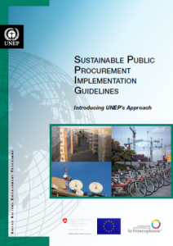
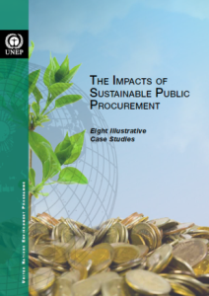
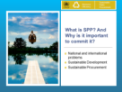
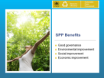
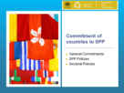
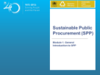
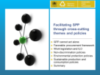
Capacity Building for Sustainable Public Procurement in Developing Countries
2009-2012
Main Outputs
Sustainable Public Procurement Implementation Guidelines: Introducing UNEP’s Approach
Study on the Impacts of Sustainable Public Procurement on Sustainable Development
Sustainable Public Procurement Training Toolkit

Slide 32
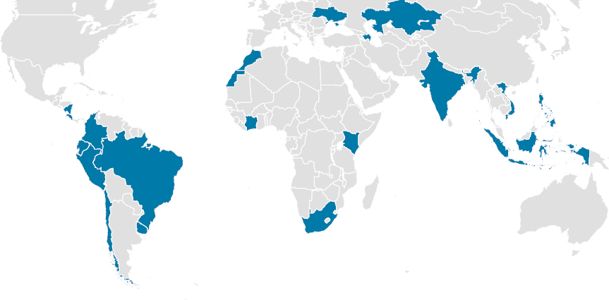
Project Countries 2013-2016
Ukraine
Kazakhstan
Azerbaijan
Morocco
India
Panama - Costa Rica
Vietnam
Philippines
Colombia
Ivory Coast
Ecuador
Kenya
Brazil
Indonesia
Peru
Mauritius
Chile
Uruguay
South Africa

Slide 33
Adoption of the 10 year framework of programmes on sustainable consumption and production at Rio+20
“We recognize that fundamental changes in the way societies consume and produce are indispensable for achieving global sustainable development. […] We adopt the 10-year framework of programmes on sustainable consumption and production patterns, as contained in document A/CONF.216/5 …”
The first 5 indicative and non-exhaustive programmes:
Consumer information;
Sustainable lifestyles and education;
Sustainable public procurement;
Sustainable buildings and construction;
Sustainable tourism, including ecotourism.

Slide 34
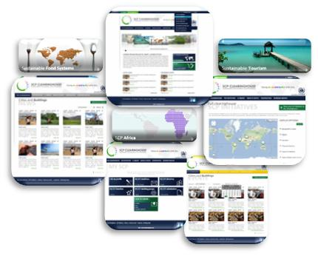
www.scpclearinghouse.org
One click away from Sustainable Consumption and Production
The first online platform dedicated to advancing SCP worldwide through information, knowledge sharing and cooperation

Slide 35
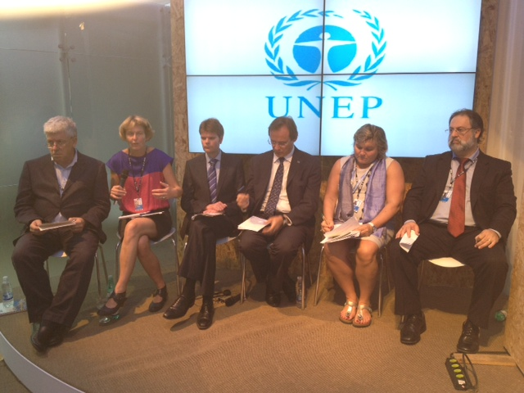
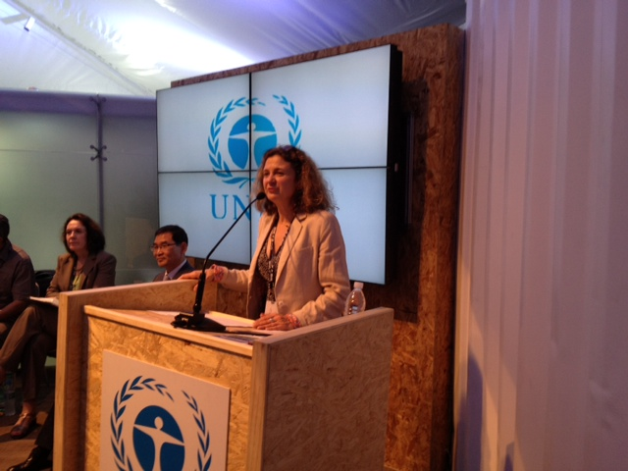
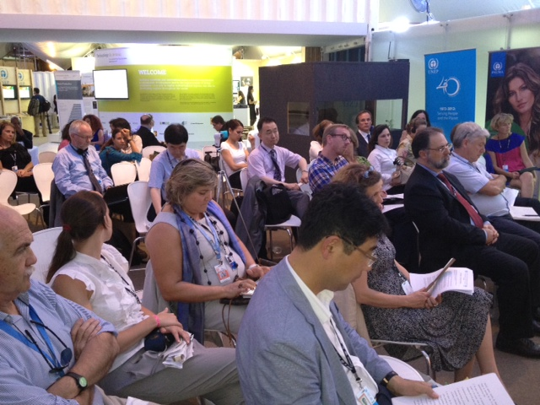
18th June 2012 – Rio+20 Summit Launch of the SPP Initiative
The SPPI is supported by over 50 members from governments, civil society and the private sector (15 new applications currently processed)

Slide 36
Initial list of participants (March 2013)
Government Organizations
ChileCompra (Chile)*
Danish Environmental Protection Agency (Denmark)*
Department for Environment, Food and Rural Affairs – DEFRA (United Kingdom)
Federal Office for the Environment (Switzerland)*
Institut des Finances Basil Fuleihan (Lebanon)
Instituto Nacional de Contratación Pública - INCOP (Ecuador)
Korea Environmental Industry & Technology Institute -KEITI (Korea)*
Ministerio de Ambiente y Energía y Telecomunicaciones (Costa Rica)
Ministry of Economic Development (New Zealand)
Ministry of Environment (Brazil)
Ministry of Environmental Protection, Environmental Development Center (China)*
Ministry of Finance and Economic Development, Procurement Policy Office (Mauritius)*
Ministry of Infrastructure and Environment (The Netherlands)
Swedish Environmental Management Council - SEMCo (Sweden)*
United States Environmental Protection Agency - USEPA (United States)*
International Organizations
Institut de l’Energie et de l’Environnement De la Francophonie – IEPF
International Training Center of the International Labor Organization - ITC-ILO
Organization of American States - OAS
Union économique et monétaire Ouest africaine - UEMOA*
United Nations Development Programme - UNDP
United Nations Environment Programme - UNEP*
United Nations Office for Project Services - UNOPS*
Local authorities
Service Cantonal du Développement Durable - Canton de Genève (Switzerland)
Federations of local authorities
ICLEI - Local Governments for Sustainability*
International Non-Governmental Organizations
Fair Trade Advocacy Office
Global Ecolabelling Network
International Green Purchasing Network - IGPN*
Forest Stewardship Council - FSC*
International Institute for Sustainable Development - IISD*
Non-Governmental Organizations
Ecoinstitut Barcelona (Spain)
Fundación Ciudadano Responsible (Chile)
Green Purchasing Network Indonesia - GPNI (Indonesia)
Green Purchasing Network of India - GPNI (India)
Green Purchasing Network of Malaysia -GPNM (Malaysia)
Groupe Vers des Achats Responsables à Rio+40 - VARRIO40 / Association CESA - Achats & Supply Chain (France)
ISEAL Alliance
Observatoire des Achats Responsables - OBSAR (France)
Sustainable Purchasing Council (United States)
Expert consultancies
BigRoom (Canada)
Corvers Procurement Services BV (United Kingdom)
Procurement Analysis (United Kingdom)
SPP Experts
Marc Steiner - Expert (Switzerland)
Observers
Royal Holloway, University of London
African Development Bank - AfDB

Slide 37
Sustainable Public Procurement Initiative (SPPI)
Goal
Promote worldwide implementation of SPP through increased cooperation between key stakeholders and a better understanding of its potential benefits and impacts.
In short: work together and make the case for SPP

Slide 38
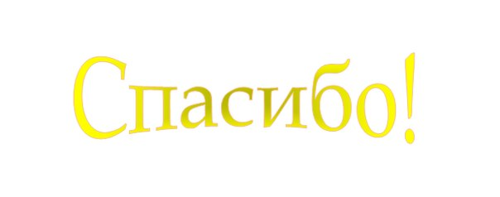
Gracias !
Obrigado !
Grazie !
Tack!
Thank you!
Terima Kasih
farid.yaker@unep.org
www.unep.org/resourceefficiency/Home/Society/tabid/55529/Default.aspx

